Slide 1

AI-Powered Automated Cybersecurity System
Team Name: MalWhere
Team Members:
Tanishka Gupta (2201CS93)
Shambhavi Verma (2201CS89)
Vartika Pathak (2201CS75)
P. Sai Laysa (2201CS61)
Tanisha Garg (2201AI40)

Slide 2
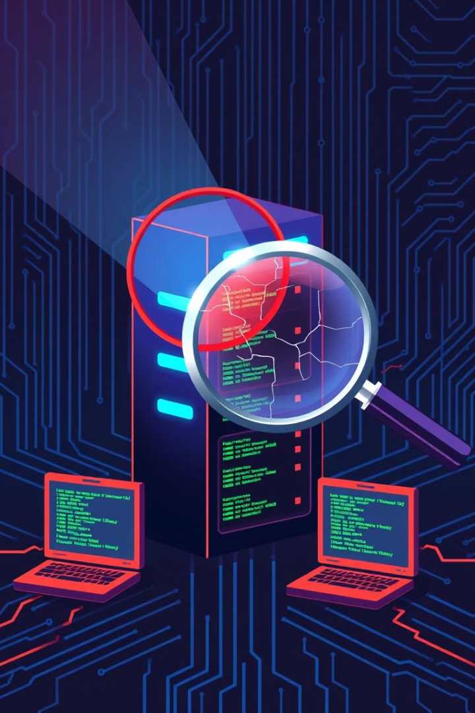
Problem Statement: Addressing the Cybersecurity Challenge
Individuals face increasing risks from cyber threats, including network intrusions, malware infections, and phishing attacks. Traditional security solutions often struggle with scalability, real-time threat detection, and high false positive rates, leading to inefficiencies in cybersecurity operations.
To address these challenges, our AI-powered system leverages advanced anomaly detection, text analytics, and computer vision techniques to enhance threat detection, reduce false positives, and improve response times.

Slide 3
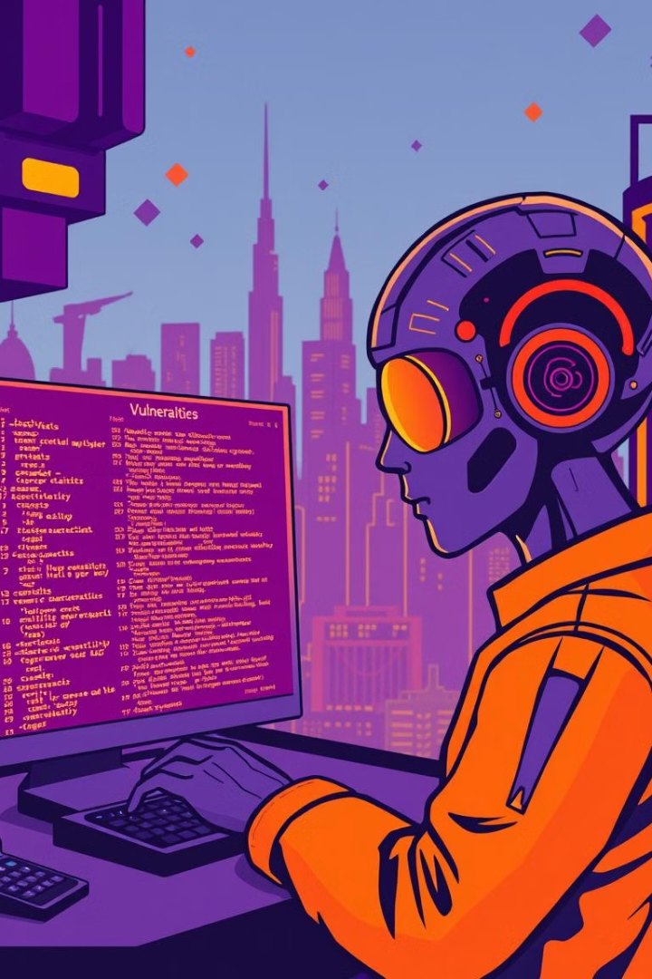




Our AI-Driven Solution
Our system leverages AI for anomaly detection, malware identification, and phishing prevention, along with the CyberShield Chatbot for online safety guidance.
Anomaly Detection (NIDS)
Malware Detection
Detects malicious files and programs.
Identifies abnormal network activities.
Phishing Detection
CyberShield Chatbot
Identifies phishing emails.
AI chatbot educating users cybersecurity.

Slide 4




Technical Implementation
Anomaly Detection
The system captures live network packets using Scapy and extracts key features like IP, port, protocol, and size. A RandomForestClassifier, trained on the USTCTFC2016 dataset, classifies packets as benign or malicious. Real-time threat detection helps identify malware-infected traffic, enhancing network security.
Malware Detection
The system extracts features from PE files using pefile and sends them to a FastAPI backend for classification. A cloud-hosted Random Forest model analyzes the data to detect malware, returning results in real-time. An automated service continuously scans the Downloads folder for potential threats.
Phishing Detection
The system continuously scans incoming emails for threats in real-time without user intervention. It intelligently categorizes emails as important, safe, or unsafe, ensuring better organization and security. Detailed logs of flagged emails are generated for security teams to review and take necessary action. Additionally, it provides users with actionable steps to safeguard themselves from potential threats.
CyberShield Chatbot
The system uses Azure OpenAI’s GPT-4 for advanced natural language understanding and real-time cybersecurity guidance. It assists in handling security incidents, advises on password security, multi-factor authentication, and secure browsing, and offers 24/7 support for threat mitigation and vulnerability awareness.

Slide 5
Azure AI Services Powering Our System
We leverage Azure AI services to enhance our cybersecurity system.
Azure AI Services
Machine Learning
API Development
Azure OpenAI (GPT-4, Codex, DALL-E)
Python
Flask/FastAPI
Jupyter Notebook
pefile
Azure Anomaly Detector
TensorFlow
Render
Azure Cognitive Services (Text Analytics, Computer Vision API)
Scikit-learn
VS Code
scapy

Slide 6
Technical Demonstration

Slide 7
Impact
🔹 Real-Time Threat Detection – Our system proactively detects network intrusions, malware, and phishing attacks, minimizing response time and reducing security breaches.
🔹 Improved Accuracy & Efficiency – Advanced ML models and Azure AI services enhance detection precision, reducing false positives and false negatives.
🔹 Scalability & Automation – Seamlessly integrates with cloud-based infrastructure to handle large-scale cybersecurity threats with minimal manual intervention.
🔹 User & Enterprise Protection – Safeguards individuals and organizations from cyber threats, ensuring a more secure digital ecosystem.
🔹 Future-Ready Security – Continuous model improvements and adaptive AI ensure evolving threats are detected effectively, strengthening long-term cybersecurity resilience.

Slide 8

Overcoming Challenges and Lessons Learned
We faced several technical hurdles during the hackathon.
Handling Imbalanced Datasets
Reducing False Positives
Fine-tuned ML models and leveraged ensemble learning to enhance accuracy in phishing and malware detection.
Applied data augmentation and resampling techniques to improve model training for anomaly detection.
Ensuring Real-Time Processing
Optimized model inference and API response times to maintain efficiency without performance bottlenecks.

Slide 9

Future Enhancements and Scalability
We plan to enhance the system with new features and improve scalability.
1
Blockchain for Threat Intelligence
Utilize decentralized threat-sharing networks to enhance security and prevent cyberattacks collaboratively.
2
Behavior-Based Anomaly Detection
Incorporate user behavior analytics (UBA) to detect insider threats and sophisticated cyberattacks.
3
Automated Incident Response
Integrate AI-driven automated threat mitigation to reduce response time and improve cybersecurity defenses.

Slide 10

Conclusion & Acknowledgment
We sincerely thank the organizers of this hackathon for providing us with the opportunity to develop and showcase our AI-powered cybersecurity solution. A special thanks to Microsoft for offering access to Azure AI services, which played a crucial role in building and deploying our system.
We truly appreciate the resources and support that made this innovation possible. Thank you!

